Slide 1
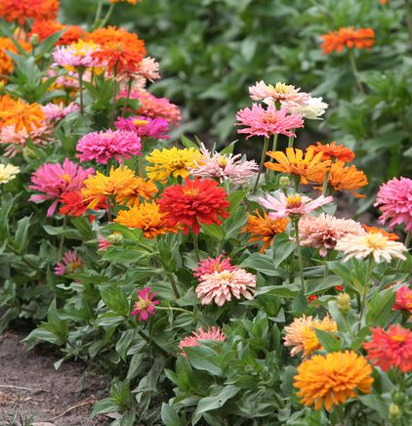
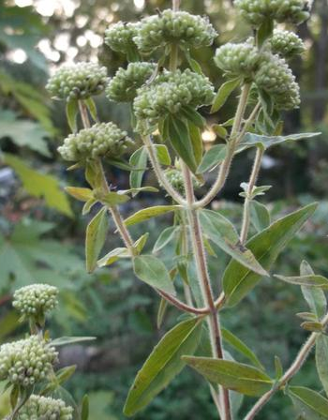
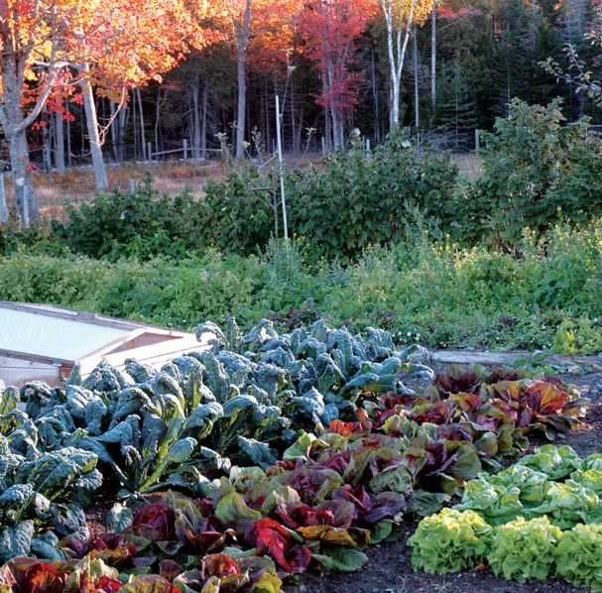
Midseason Gardening Challenges and Reframing for the Future
Notes:
Our time today is:
Discuss a few common issues happening NOW in the garden and things you can do NOW to manage it.
Reframe how we see these problems to better prepare for spring
Question and Dialogue last 20 minutes or so.
Rules:
Feel free to ask questions

Slide 2
Notes:
A little about the SWCD
Every county in US.
Protect and enhance our soil and water resources.
We have a vision in which everyone participates in the act of conservation.

Slide 3
Conserve
To “conserve” means, literally, “to save together”.
Notes:
Question: How do you feel when you see a woods being cut down or a farm field being developed into housing?

Slide 4
Possessive/Objective Relationship and Responses
Reacting to unknowns and threats to protect simplicity and possessions.
Control leaves the gardener satisfied.
There is a product or material “out there” that can protect the “object”
Totalitarianism: “This food is mine. There is to be no evidence of insects anywhere.”
Issues are meant to be overcome.

Slide 5
Ecological/Subjective Relationship Responses
Respond to unknowns as an opportunity for additional complexity, diversity, and mystery.
Focus on building system resilience to extremes (e.g. draughts, floods, climate change).
Trust leaves the gardener satisfied.
“There is an imbalance/symptom in the ecosystem and my role is to assist restoration.”
Egalitarian: “This garden is for me, my friends, and non-human friends.”
There are no “issues” – only misunderstandings that require patience, humility, and trust.

Slide 6
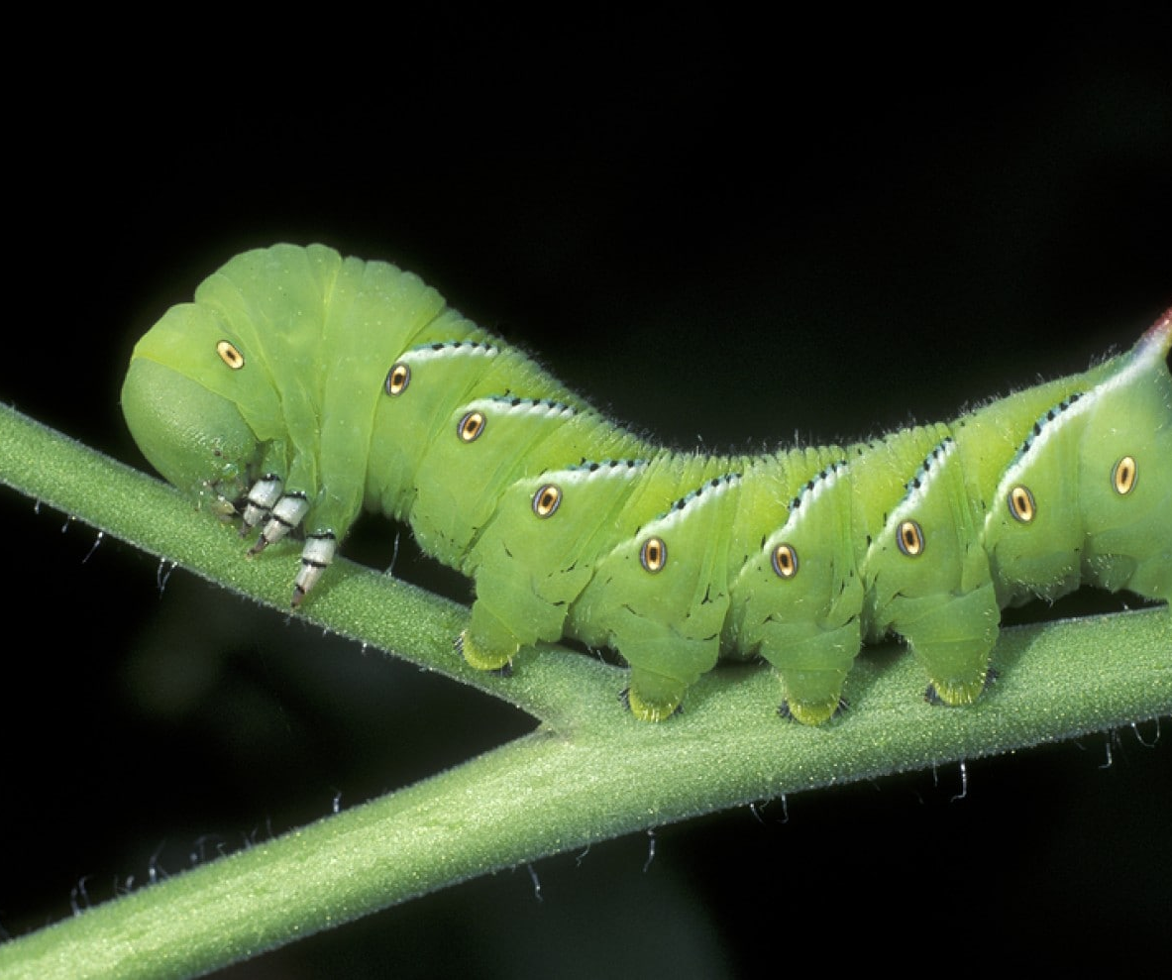
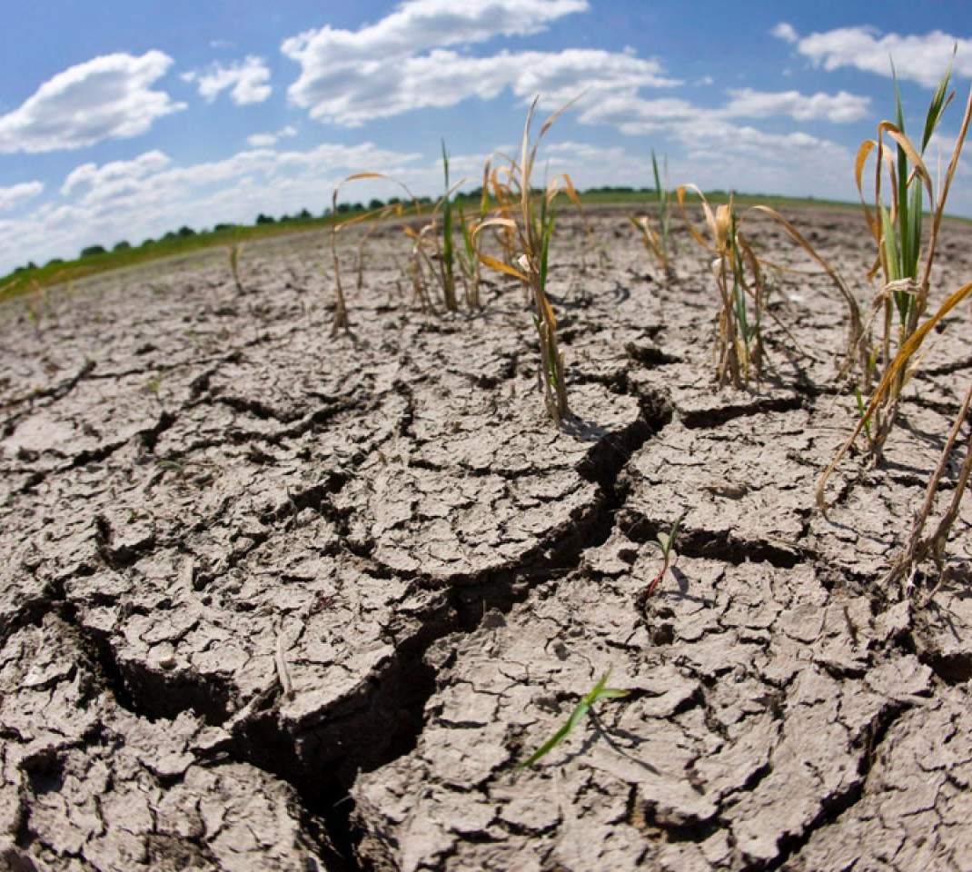
Material/Object Response to Common Midseason Garden Issues
Watering and Dryness (Draught)
Disease, Fungus, Mildew
Pests (Insects)
Weeds
Heat
Improper or no pollinization

Slide 7
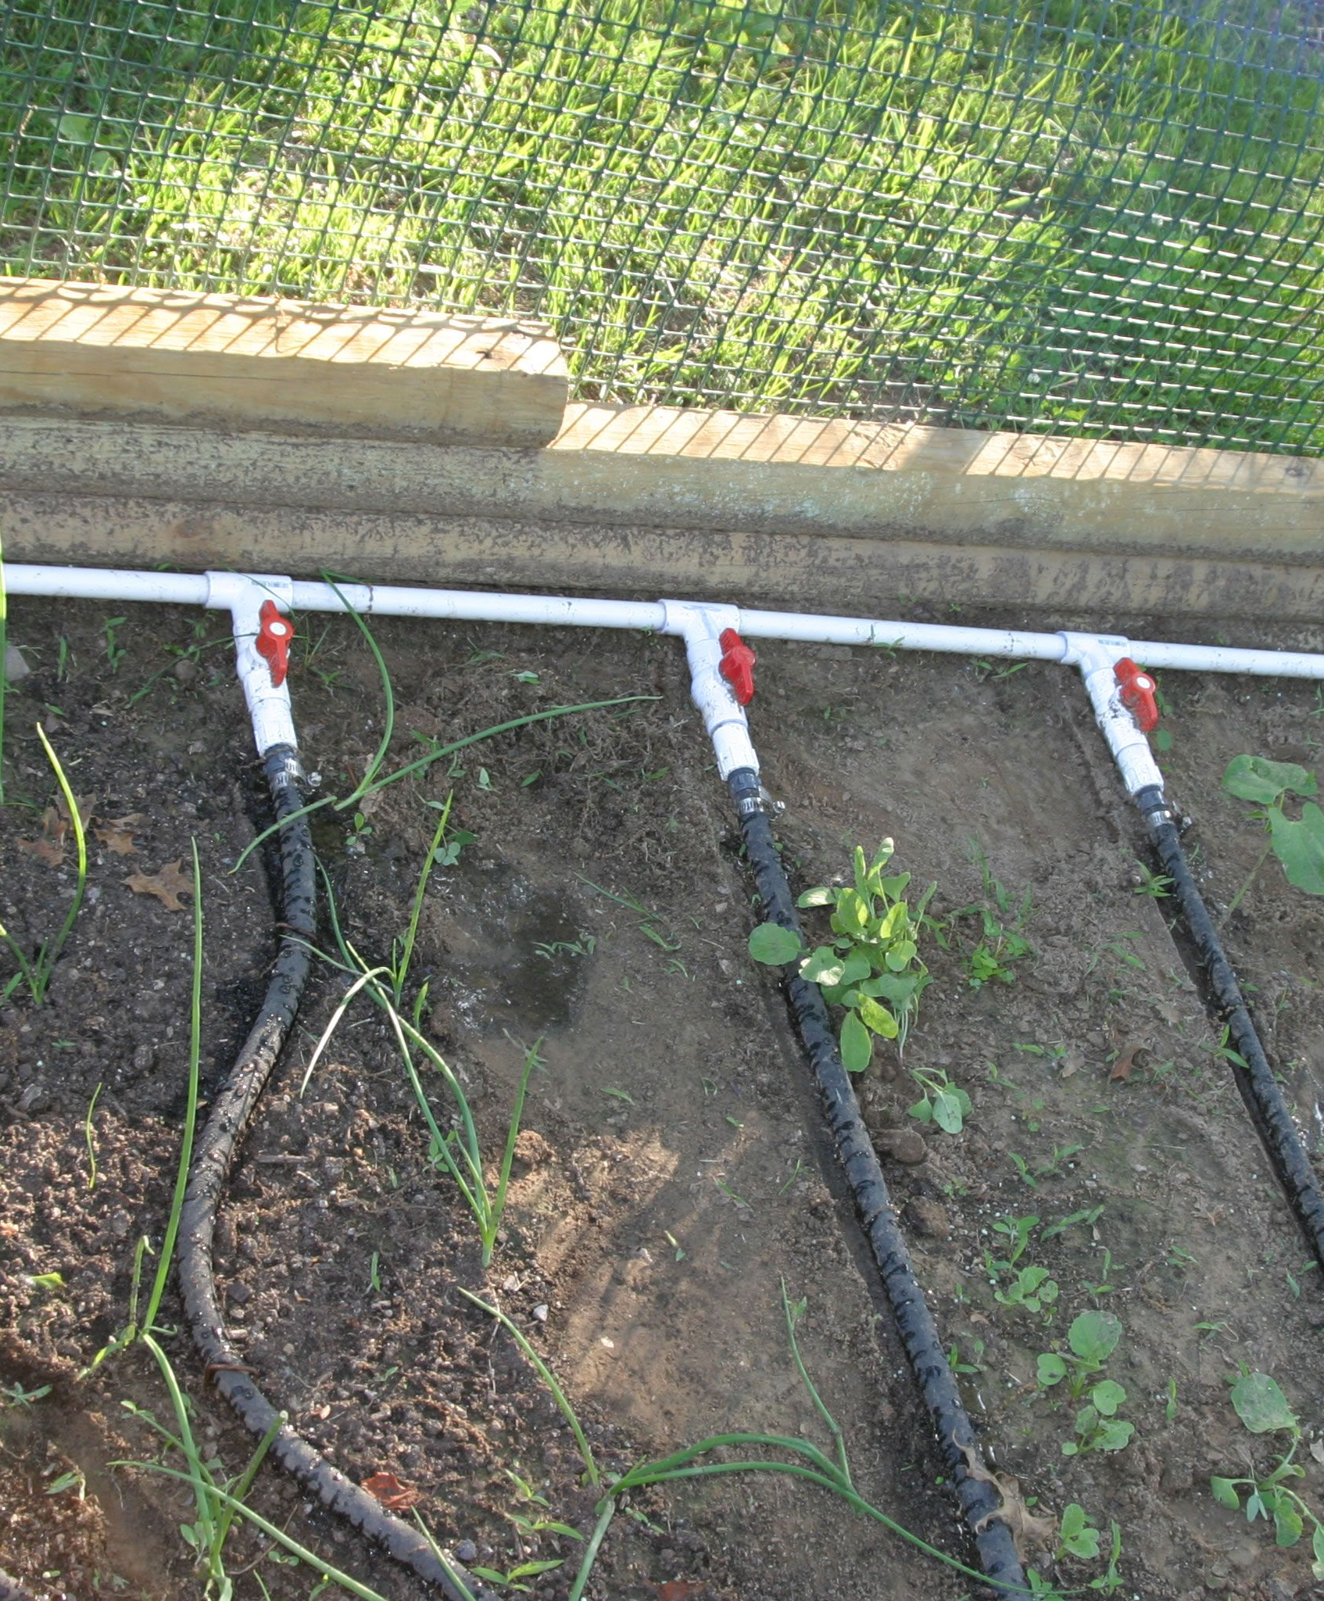
Dryness and Draught
Simple soaker hoses will work
More efficient than overhead spray
Parts are easy to find at hardware and garden stores
Use with PVC and an assortment of barbed fittings and connections to hose bib connection (outdoor spicket)

Slide 8
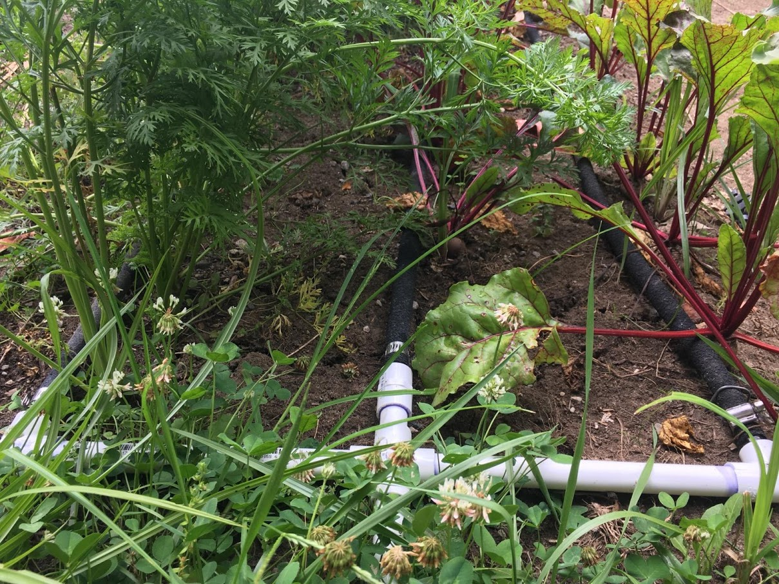

Slide 9
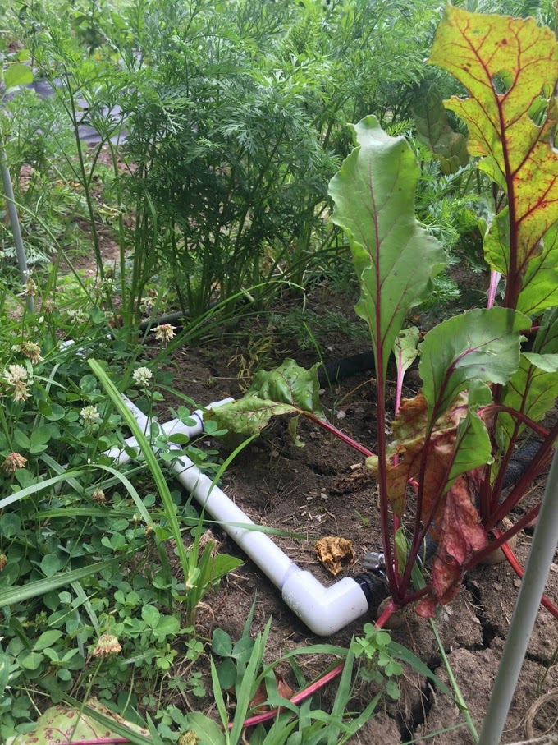
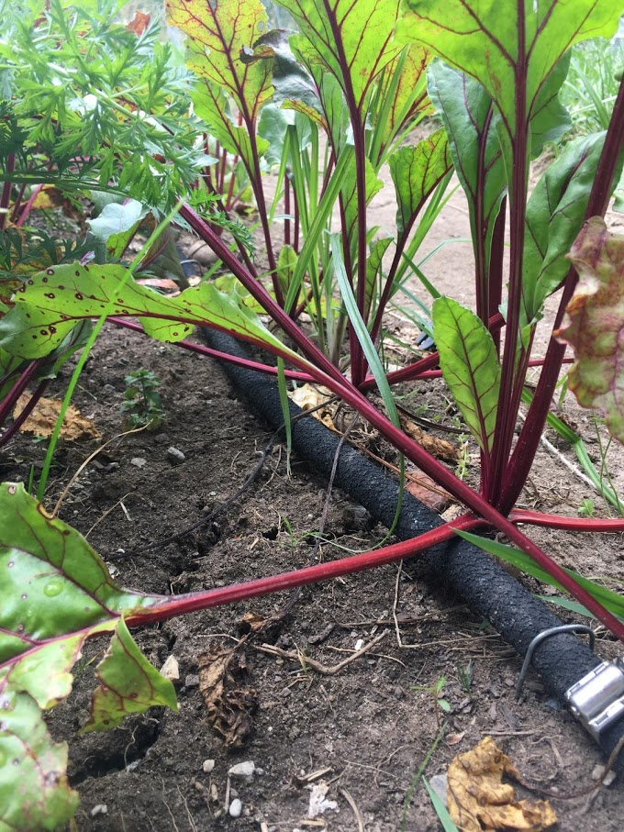

Slide 10
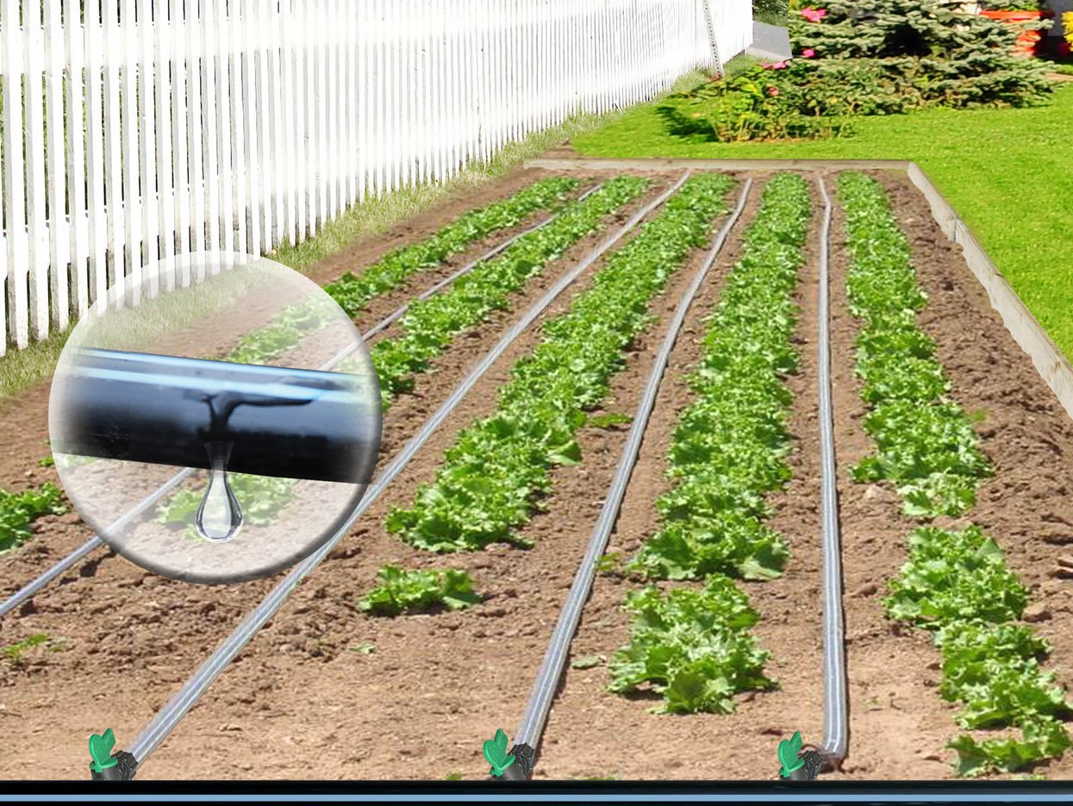
Emitter Tubing
Very efficient
Usually cost effective
Maybe a shorter life-span
Lasts longer if covered with opaque synthetic or natural mulch
Notes:
Emmitter hosing

Slide 11
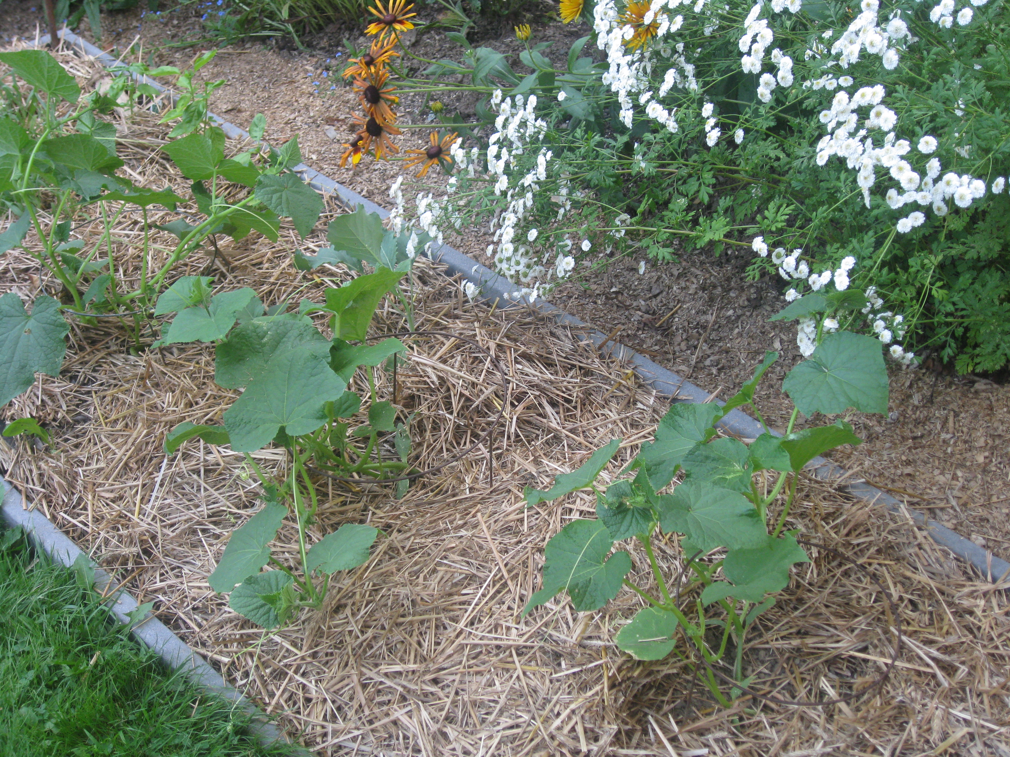
Notes:
MULCHING
Lots of options, straw, chopped leaves, wood mulch (maybe),
STRAW: Best kind is seedless, if possible. But that’s very difficult to find.
MULCHED Leaves and untreated grass/lawn clippings: Works but can be hydrophobic
OPAQUE Landscape fabric: Works great as long as water can go through the fabric OR there is irrigation underneath it.
LANDSCAPE FABRIC works okay but usually allows light through which means weeds will still grow and cause issues.

Slide 12
Disease, Mildew, and Fungus
Must identify through symptoms first
Once identified a specific solution can then be tested
Apply synthetic or organic fungicides – or other concoctions (e.g. hydrogen peroxide, baking soda, etc.)
Prune off dead, drying, or infested parts of plant and throw in hot compost pile or burn (to contain pathogen)
Prune unnecessary parts of plant to allow for more air circulation

Slide 13
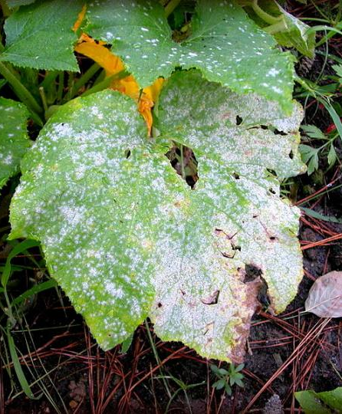
Powdery Mildew
Thrives in warm, dry climates (like now)
But…spreads due to humidity around the plant by fungal spores
Rarely kills the plant but will weaken it and reduce yield
Spray/treat with fungicide
Sulfur, lime-sulfur, neem oil, potassium bicarbonate
Spray with bicarbonate solution (baking soda)

Slide 14
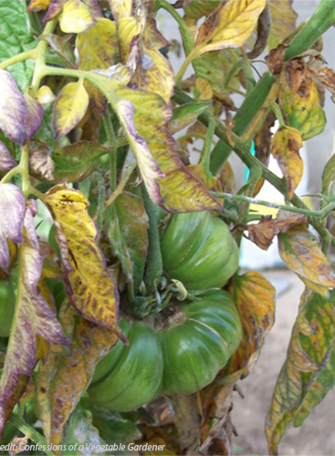
Verticillium Wilt
Disease looks very similar to Early Blight or Bacterial Canker
No effective chemical treatment available
To slow the disease, use fertilizers lower in nitrogen and higher in potassium
Destroy infected plants
May survive but will be stunted.

Slide 15
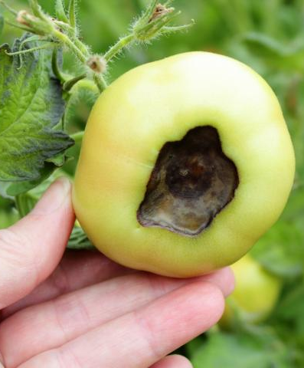
Blossom End Rot
Not a disease but a physiological issue with wet springs and dry summers (like now)
Get a “basic soil test” from HCSWCD to determine pH and calcium levels.
Discard the tomato
Use irrigation to evenly water. Use mulch to help balance dry and wet scenarios

Slide 16
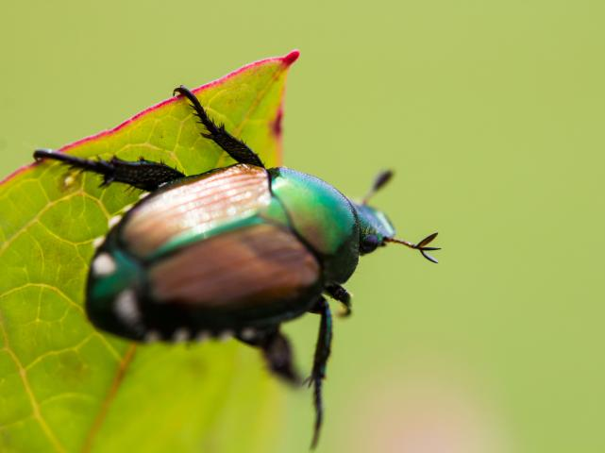
Pests (Insects)
Nothing
Hand picking
Chemical or biological application
Insect netting (may be too late, anyway)
Importing predatory insects (in controlled situation)
Repellents and traps

Slide 17
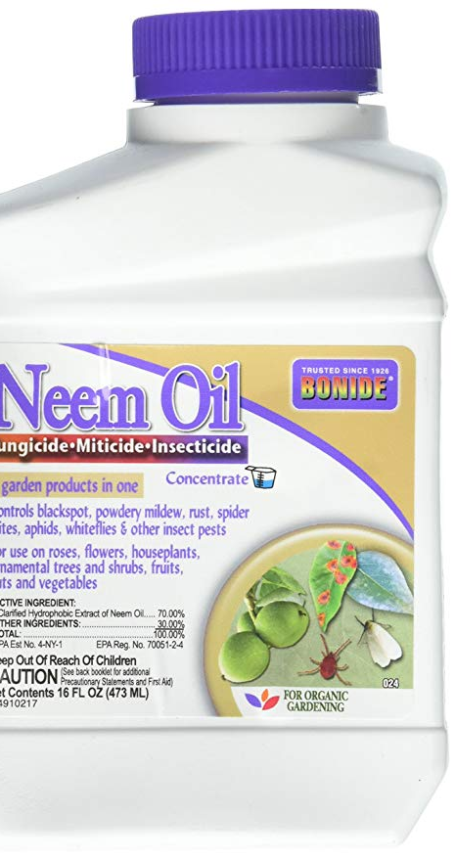
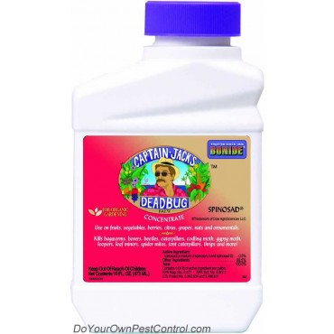
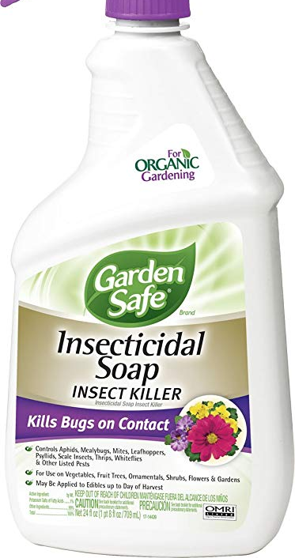
Common Organic Pesticides
Notes:
Neem Oil - Neem oil is a vegetable oil pressed from the fruits and seeds of the neem of India
BT (different kinds available now) - Bacillus thuringiensis – is a bacteria that once ingested by beetles, catterpillars, or worms, will disrupt the stomach/gut and kill the insect.
Used for black flea beetles a lot.
Spinosad - Spinosad is a natural substance made by a soil bacterium that can be toxic to insects.
Nematodes
Insecticidal Soap
Dichotomous Earth

Slide 18
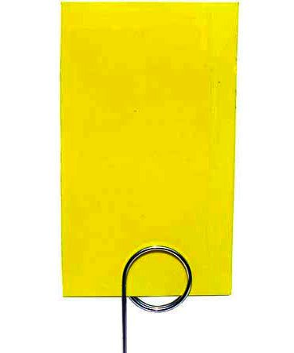
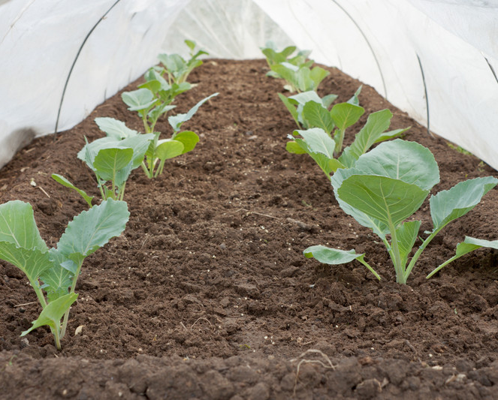
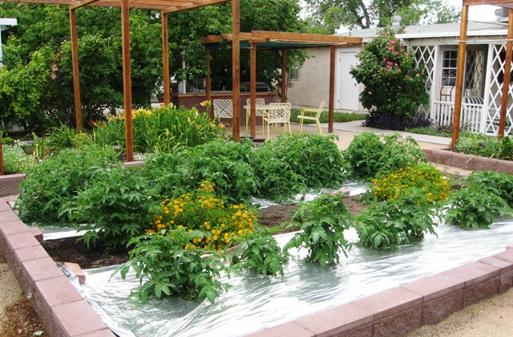
Repellents and Traps
Notes:
Reflective Mulch – Great for white flies or other insects that like to be under the leaf.
Floating Row Covers
Yellow Sticky Traps – Great for black flea beetles
Of course, there are marigolds and zinnias along with many herbs like catnip, etc.

Slide 19
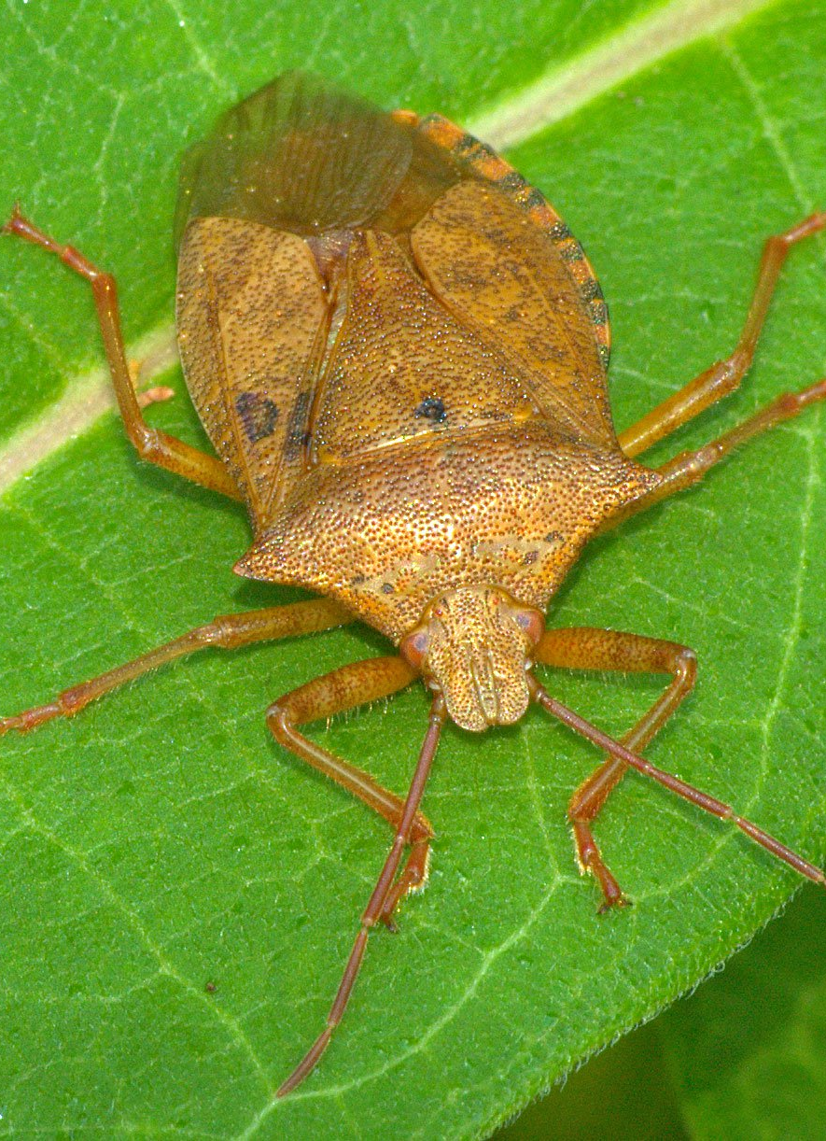
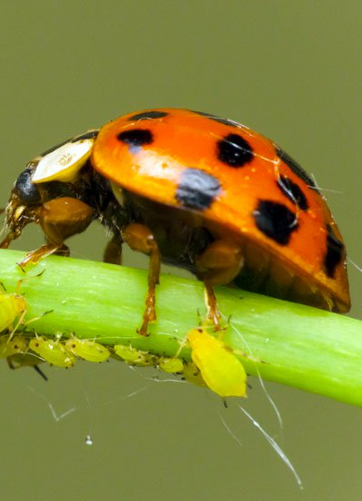
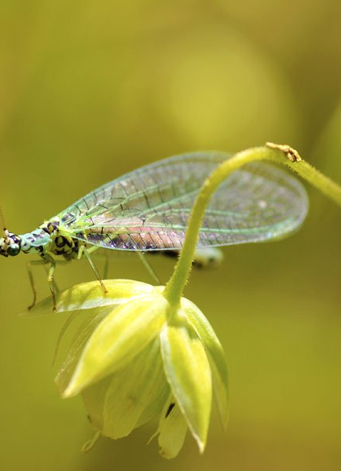
Importing Beneficial Insects
Notes:
Purchasing Beneficial Insect Predators that are Commercially availablehttps://www.planetnatural.com/product/live-ladybugs/
Green Lacewing - feed on a large number of soft bodied pests, mites and insect eggs. A voracious predator, they can consume as many as 60 aphids an hour.
Lady Beetles - aphids (40-50 per day) and a wide variety of other soft-bodied pests, mites and insect eggs.
Spined soldier bug - is a voracious predator of over 100 different insect pests, including the larvae of Mexican bean beetle, European corn borer, corn earworm, cabbage looper, cabbage worm, Colorado potato beetle and flea beetles.

Slide 20
Weed Management
Pulling
Herbicide
Mulching

Slide 21
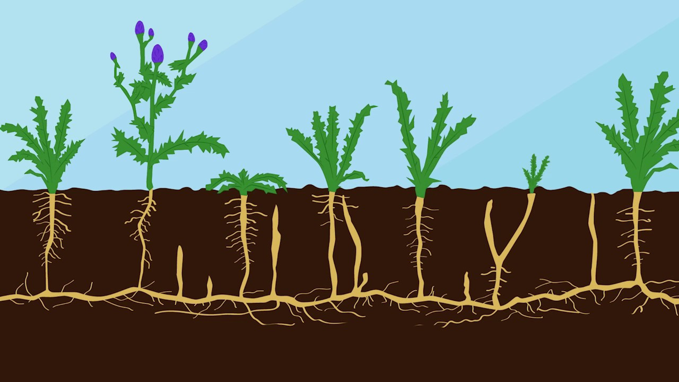
Canada Thistle
Cut at the base – do not pull
Continue to do this until the roots are exhausted or…
And/or treat with herbicide with eyedropper or spray

Slide 22
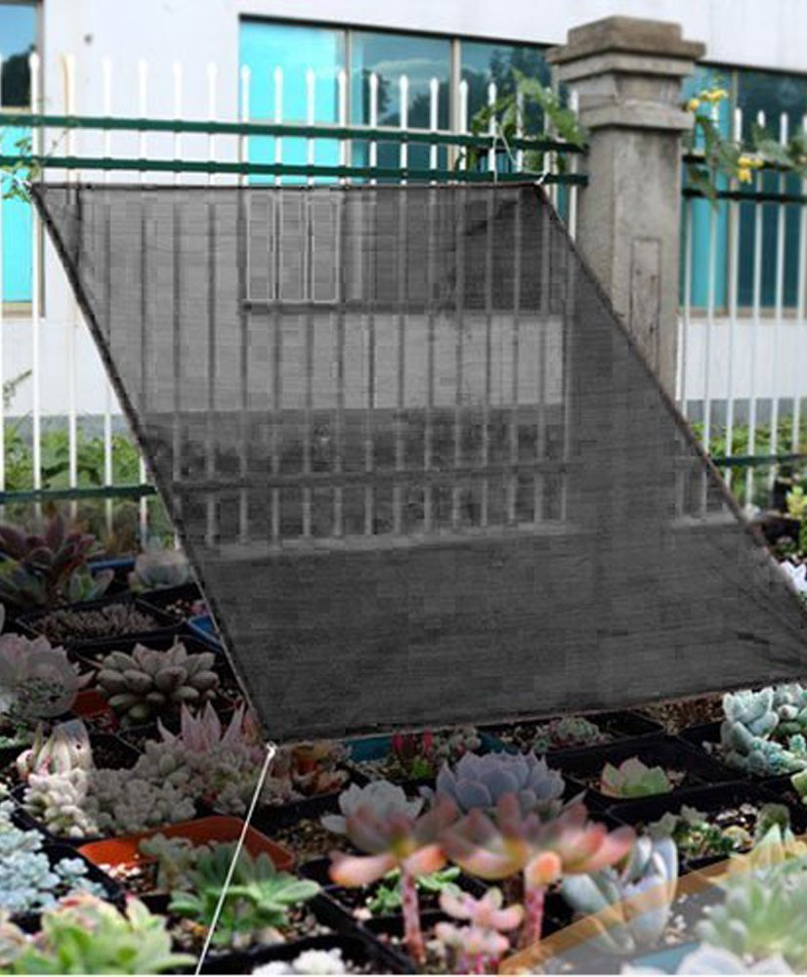
Heat
Shade cloth
Lettuces: Overhead sprinklers
Irrigation

Slide 23
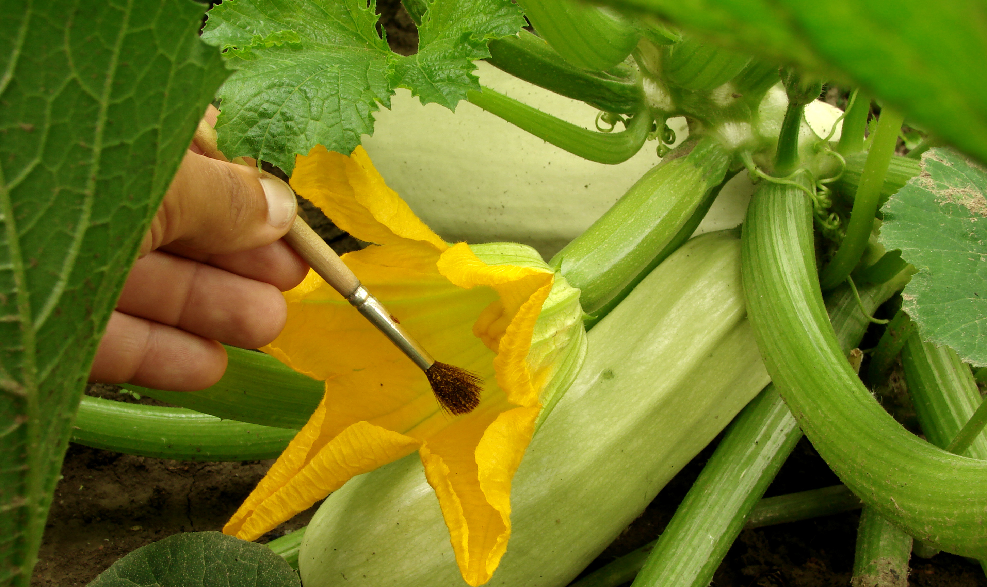
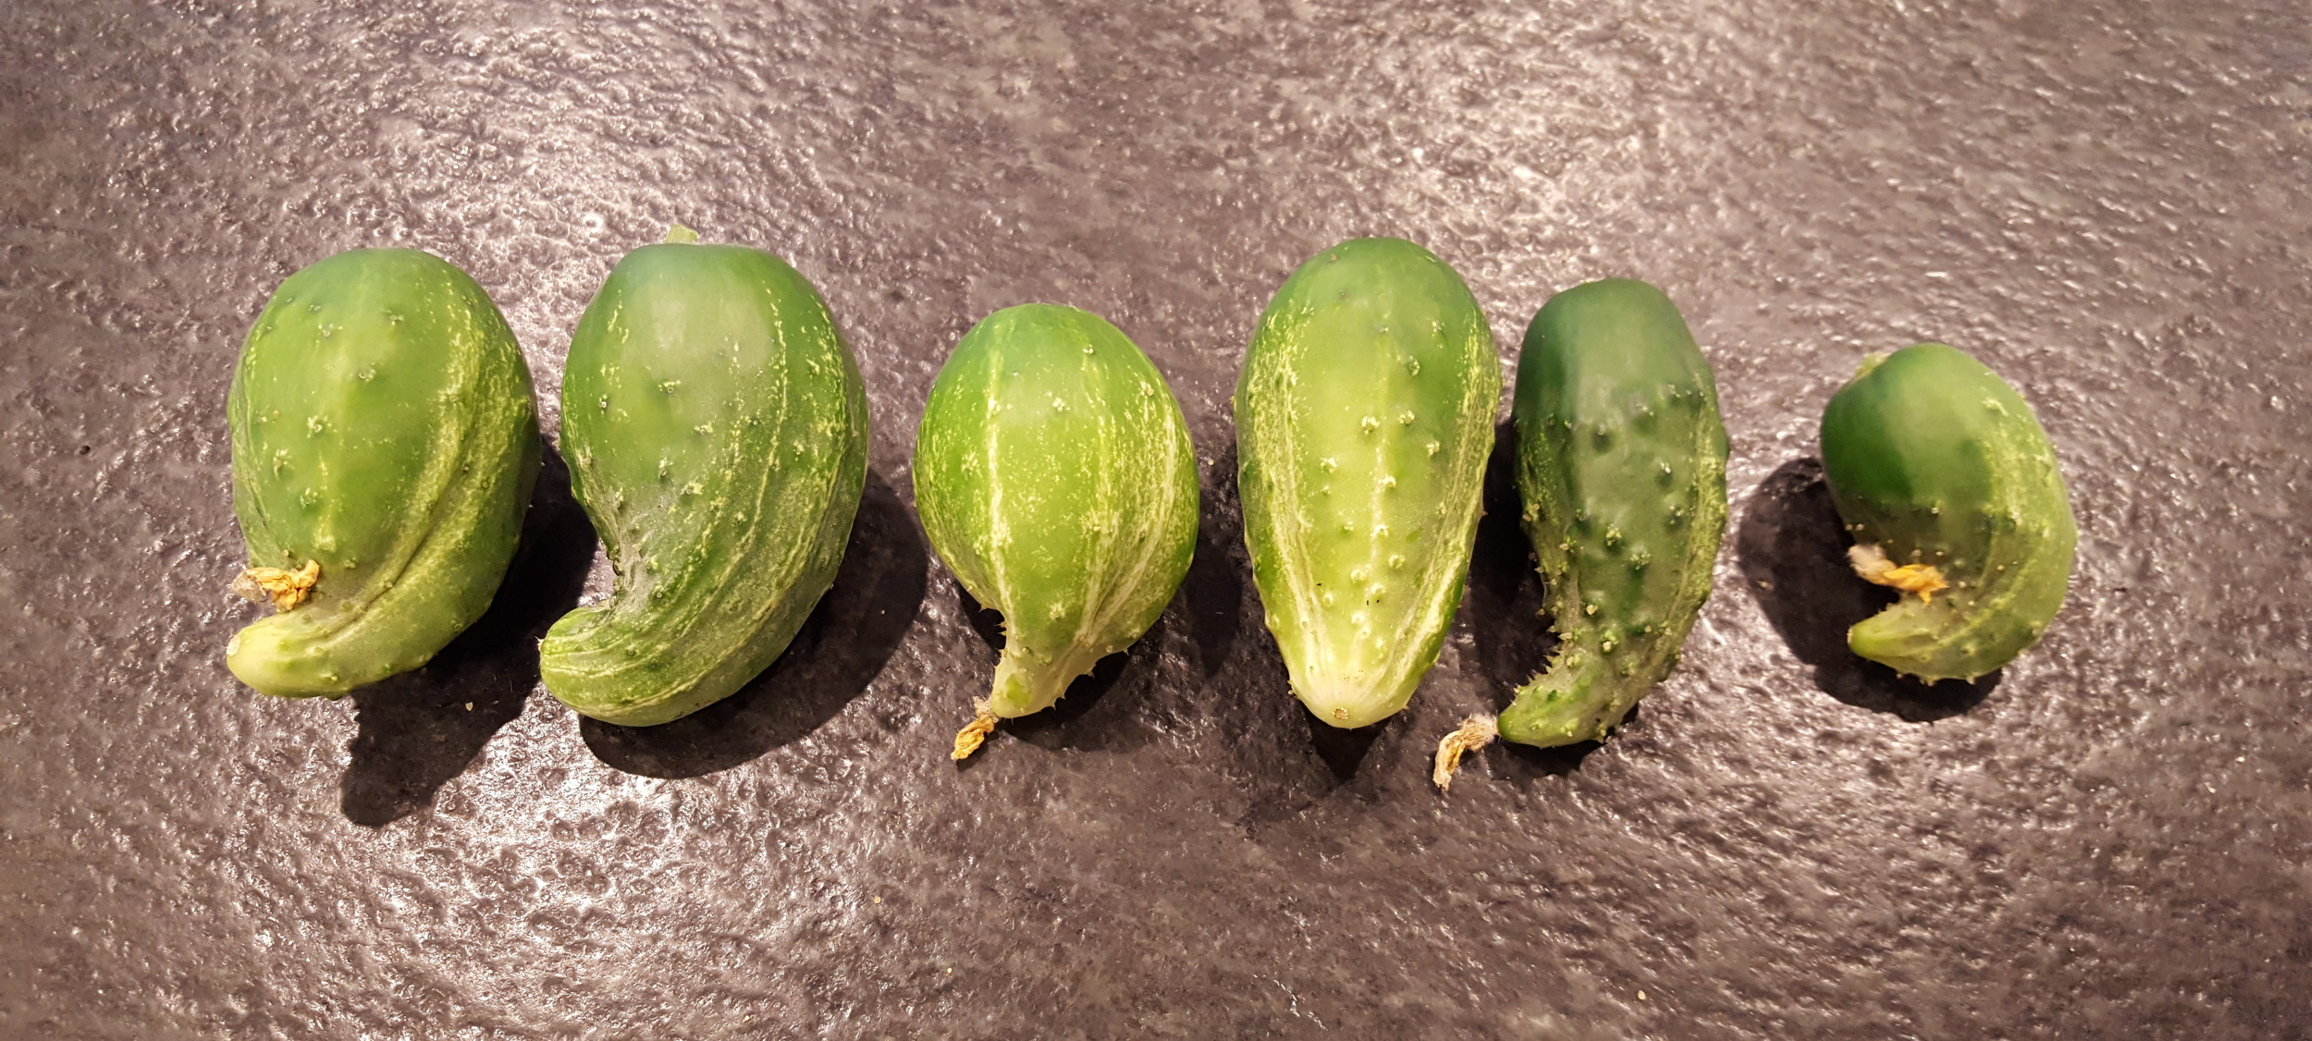
No or Improper Pollination
Hand pollination
Cooling the environment: heat can prevent proper pollination

Slide 24
Notes:
Conversation…

Slide 25
Ecological/Subjective Relationship Responses in the Garden

Slide 26
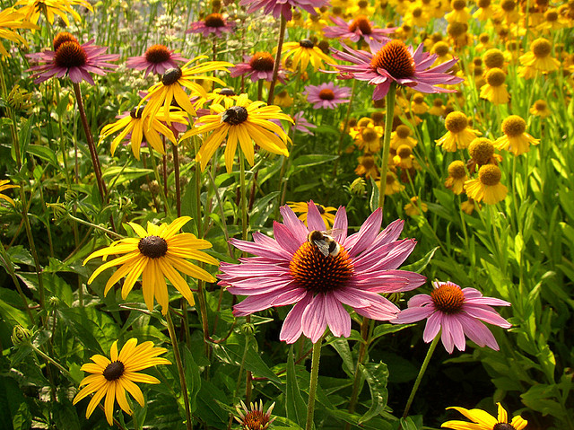
A problem in the garden is an invitation to relationship.

Slide 27
Ecology = Family
Each plant, microorganism, and animal is uniquely adapted to a very specific environment. One little shift sets off a chain reaction with intense changes somewhere else.
Notes:
For example, an oak tree can support hundreds of species of plants and animals. Whereas a callery pear tree, which is invasive, only a few. A family that knows each other for a longer time supports each other.

Slide 28
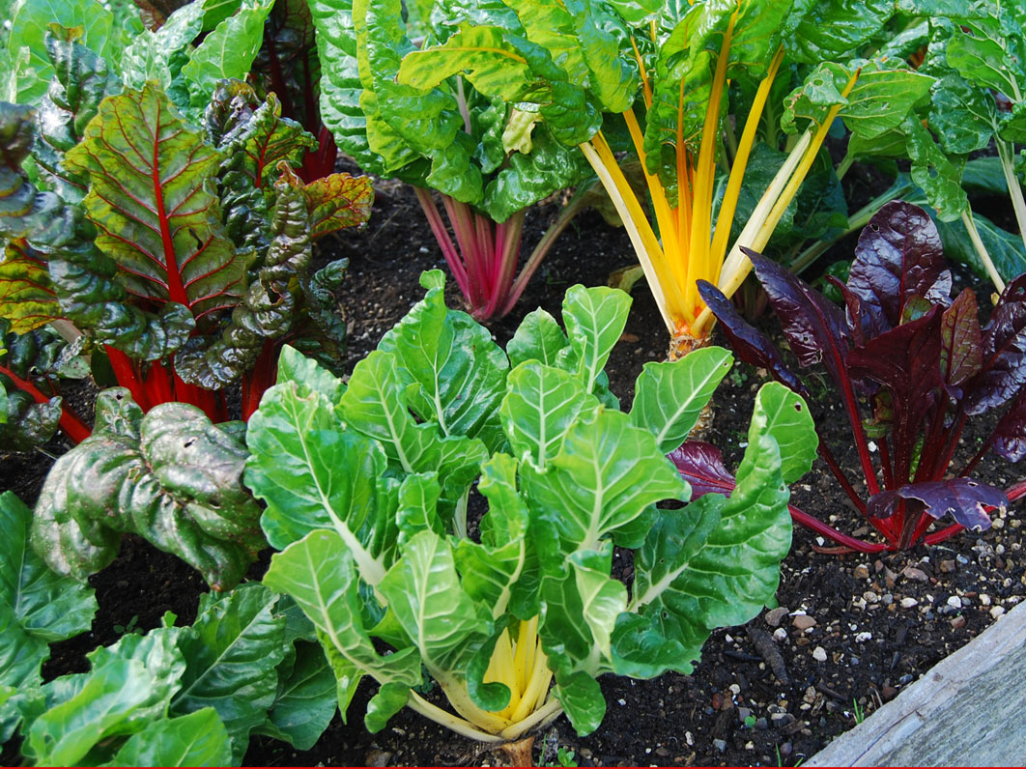
It starts with the soil It starts with the soil It starts with the soil It starts with the soil It starts with the soil It starts with the soil It starts with the soil It starts with the soil
Notes:
What you are doing is

Slide 29
Soil is the Plant’s Immune System
Notes:
Many definitions to soil health but I will broadly summarize it here:
When the soil is healthy, your plants are healthy, and we are healthy.
Insects attack plants that have a nutrient imbalance or deficiency first because those plants don’t have a defense mechanism.
Soil health nurtures and protects the soil microbiome and organic matter.
When the soil microorganisms are thriving, they deliver nutrients to the roots – that’s how it happens. (that’s why they need water).
AND – when the soil is thriving with bacteria and fungi, we inhale that or it gets on our skin and that boosts OUR immune system too!
Plants actually talk to one another through the microorganisms in the soil!!! Remember Avatar? It’s not science fiction – it is really true!
Shift in mindset from growing food to growing soil.
When this happens, soil is more porous yet holds more water, is better capable of mitigating diseases, holds more nutrients for longer, and more.
Most soil health practices have multiple benefits.
I am fairly convinced that if we focused on building soil organic matter and practice good soil habits there would be few, if any, disease issues. And, if there were, then it was meant only to restore balance in the ecosystem.
So, how do we build soil health?

Slide 30
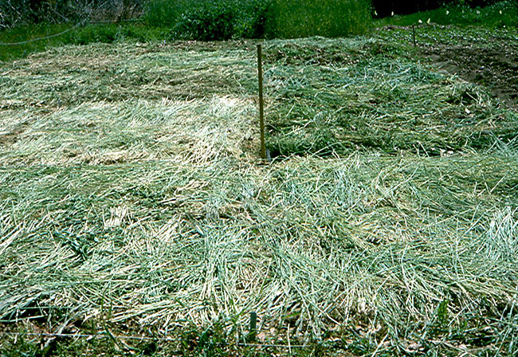
No-Till
Notes:
Limit tilling if at all possible to the top two inches except in cases where noxious weeds, disease, or pests, can be eliminated through its use.
Tilling is good only momentarily as it brings more oxygen to microbes which feed the soil.
But, in the long run, and if used too much, it will exhaust the soil of organic matter which is where soil fertility and its immune capacity is stored.
This can also limit weed pressure.
How do you garden with no till?
If you use cover crops, or limit tilling to the top two inches, the soil, in combination with worms and other soil microbiology, and assuming you continue to add organic matter, will sort itself out.
It is possible to plant starts and seeds in soil that has not been tilled. It’s very easy. It just may not look as pretty.
It is best to be gentle with the soil so the components in the soil can do its job.

Slide 31
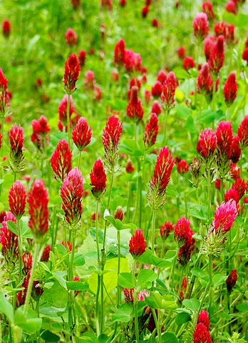
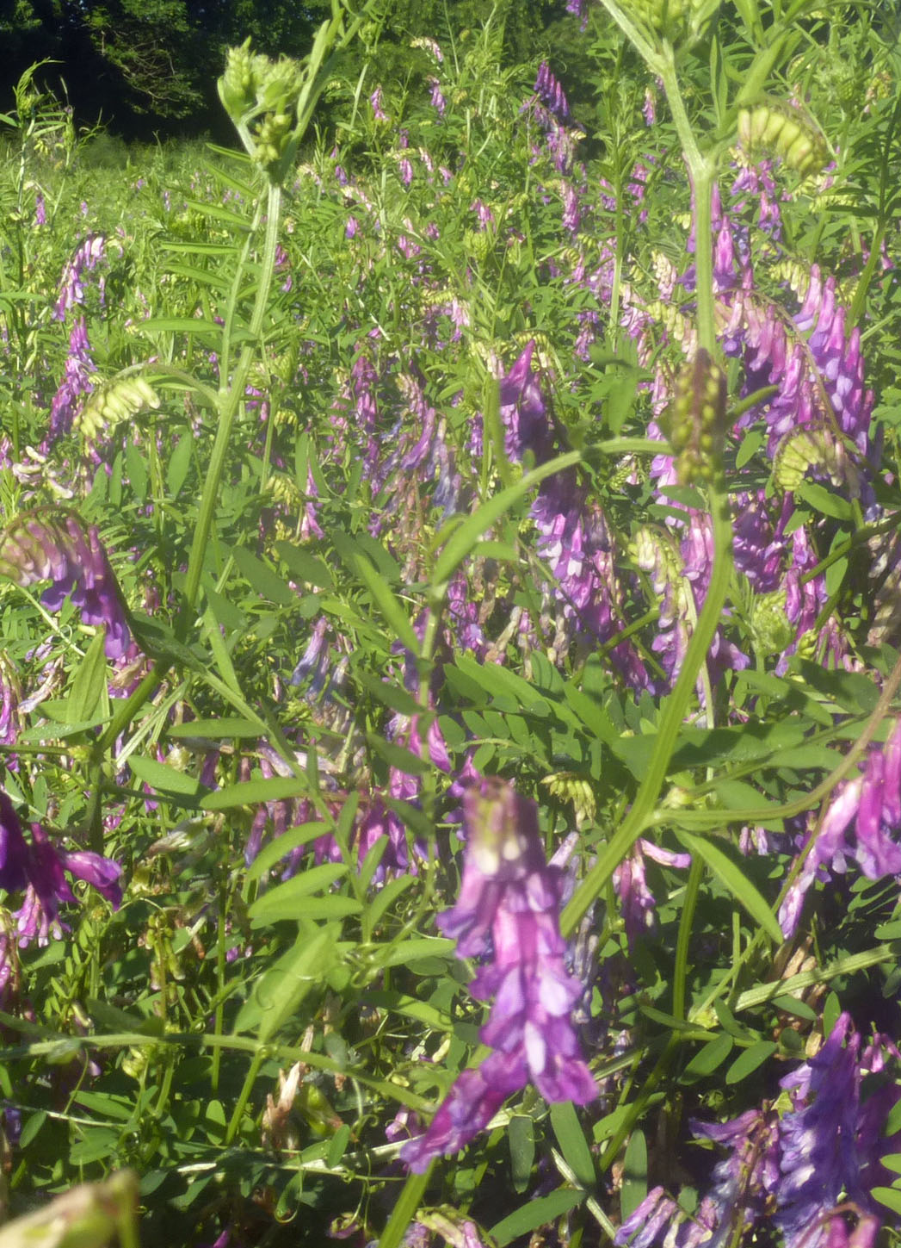
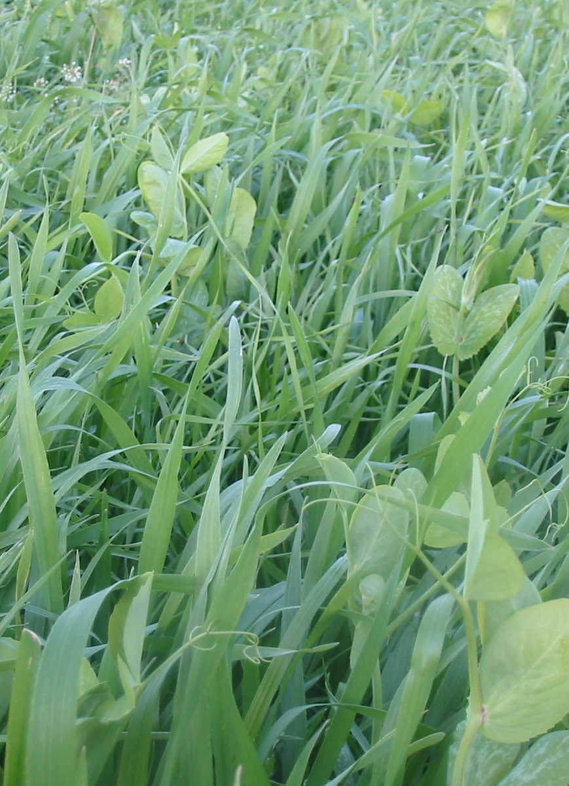
Cover Crops
Notes:
Cover Crops
I could spend hours on cover crops.
Cornucopia of benefits
In short:
They add organic matter.
They keep soil alive during the winter for microbes and other soil microbiology to continue to thrive
They add nitrogen
They decrease weed pressure
They can make phosphorous more available
They improve soil texture – rye, for example – with its roots.
Some decrease fungal disease pressure, like Austrian Winter Peas – which is good for tomato plant lovers
The residue can be used as a mulch to suppress weeds, retain soil moisture, and add organic matter as it decays.
Beneficial insects LOVE cover crops.

Slide 32
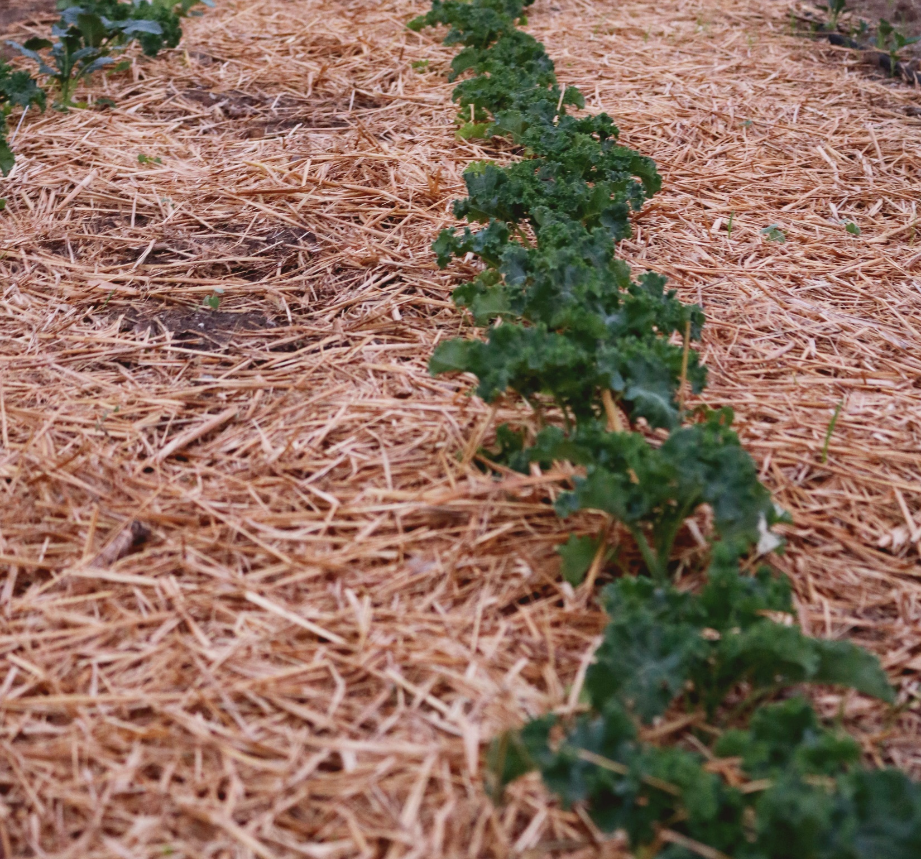
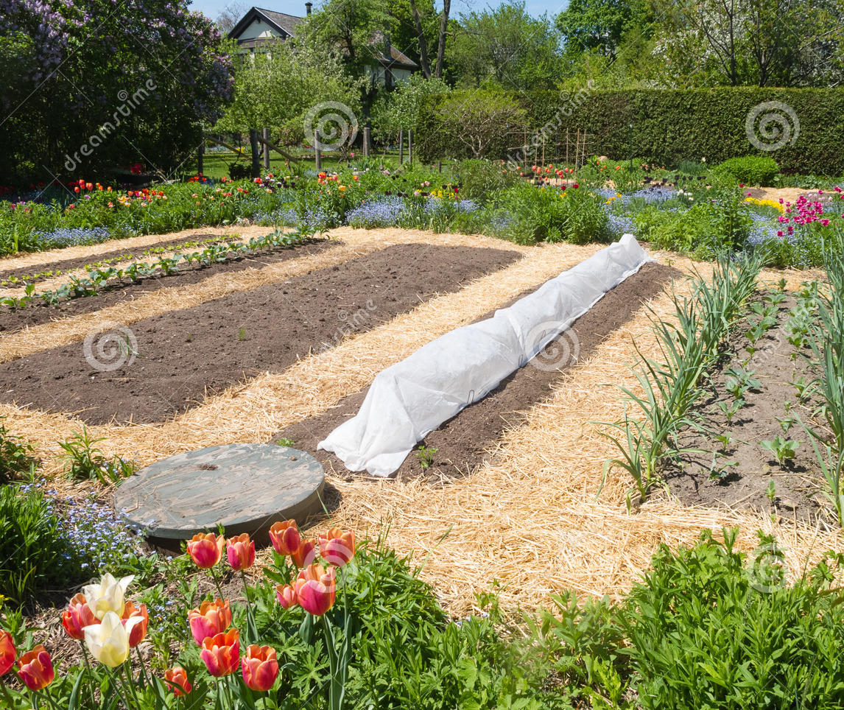
Mulching

Slide 33
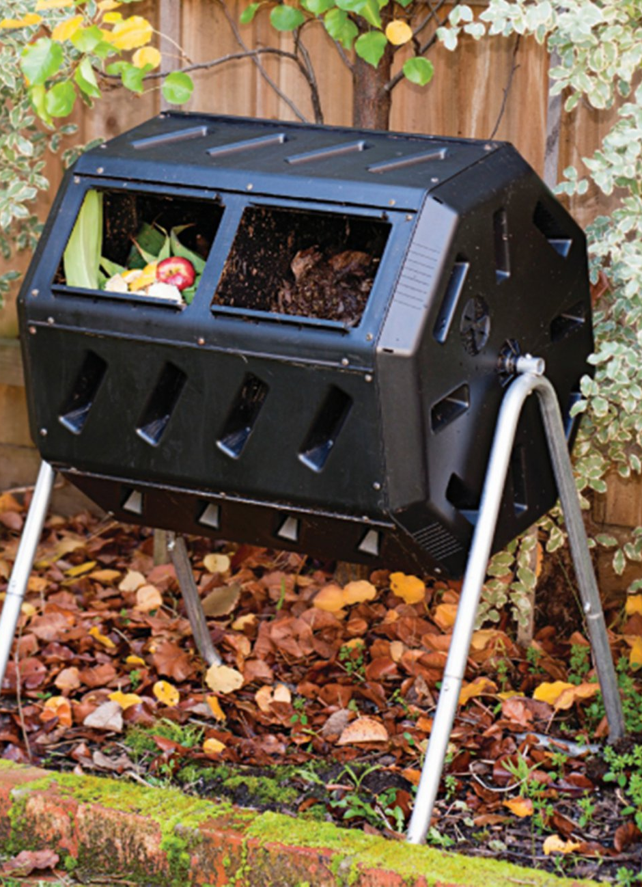
Composting
Notes:
Probably the most obvious and most expected practice of organic gardening.
Law of Returns – Returns waste as soil with little energy required.
Adds humus and therefore the capacity of the soil to store fertility and provide habitat for soil microbes.
Won’t get into detail, but, all organic matter composts….eventually. All you need is a pile.
Compost can be expedited or refined to meet certain nutrient requirements by turning and mixing the right type of dead and living material (nitrogen to carbon ratio) etc. (I won’t go into detail).
Depending on the size of the garden, and the amount of compost, you may or may not meet the requirements of your garden.
One way to add a lot of compost is to add untreated grass, kitchen scraps, leaves, and so on.
Leaf compost is some of the best compost.
Composted manure is a great source of organic matter.

Slide 34
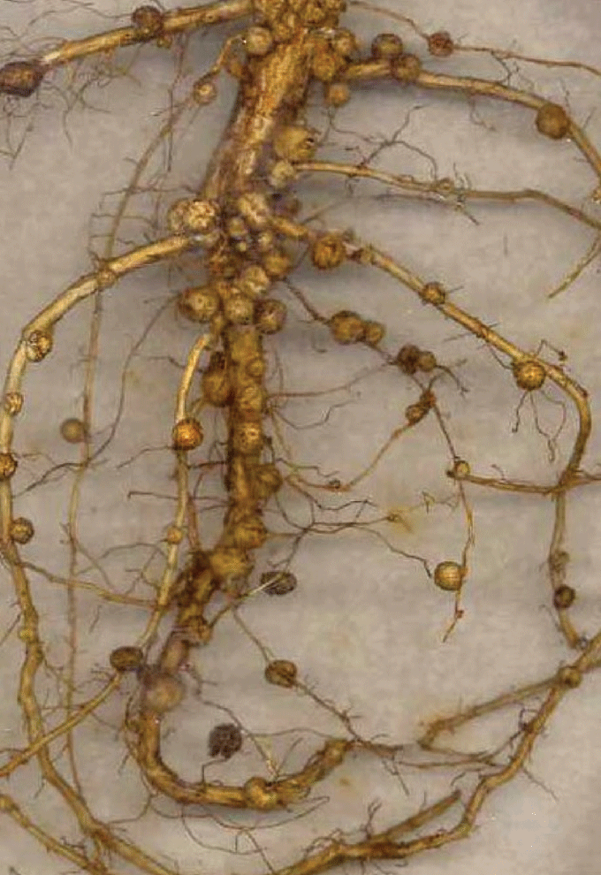
Soil Inoculates
Notes:
Disturbed soil, especially in urban areas, lack the bacteria needed to perform essential functions for plants and soil.
Soil inoculates replenish microbes, bacteria, and fungi into the soil
They are responsible for the transfer of nutrients to the roots
A soil without much microbial life is more open to disease.
These little guys protect the plant!
Can be purchased online.
One popular one is….

Slide 35
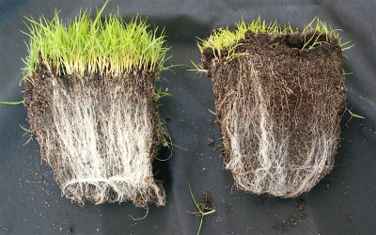
Innoculating w/ Mycorhizza Fungi
Notes:
Microbiology, the bacteria, fungi, and other life that lives in the soil is critically important because it performs a host of responsibilities
Mycorhizza fungi, for example, is critically important in transferring water and nutrients to the roots of the plants.
Synthetic fertilizers, chemicals, and tilling, for example, disrupts this and can kill mycorhizza fungi. This is why it is important to be gentle with the soil.

Slide 36
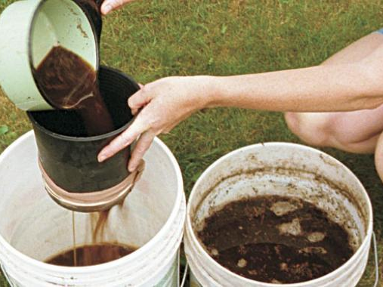
Compost Teas
Notes:
Compost tea is a great way to inoculate the soil.
Grab a collection of healthy soil from your compost, worm compost, or other natural areas.
Put it into a sock and hang from a a 5 gallon bucket
Add molasses for sugar
Aerate for 24 hours
Filter into a sprayer or watering can
Inoculate the garden!

Slide 37
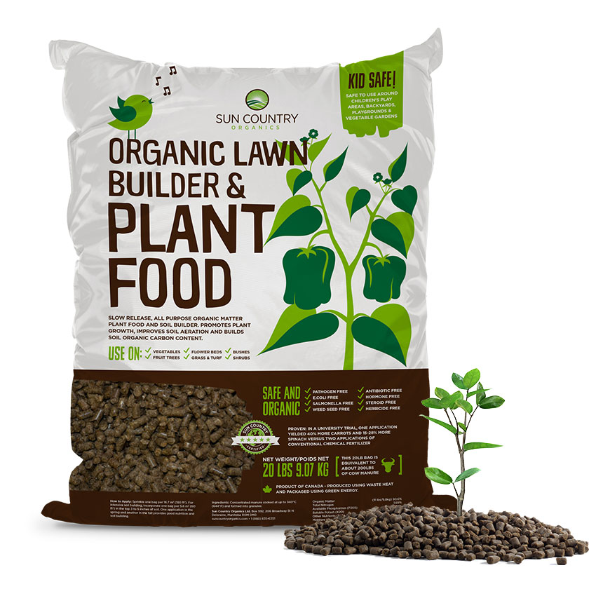
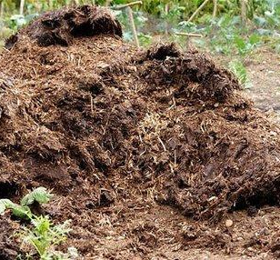
Organic Fertilizers
Notes:
Simply put, organic fertilizers come from organic sources – they are not synthetically produce.
They function differently in the soil because the contain organic matter and are typically slower releasing.

Slide 38
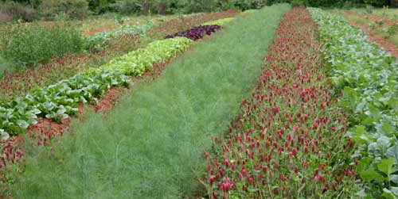
Crop Diversity and Crop Rotation
Notes:
I believe that crop rotation would cut tomato fungal issues significantly.
Planting the same plants within the same plant family, even if it shows few symptoms of issues, in the same spot year after year increases the pathology and chances of disease.
Best thing to do is to rotate crops by families and limit crops that seem to be stressed by insects and infections.
Part of the reason why is because the different species of soil microbes interact with different plants – it’s good to be supportive of the soil in this way.

Slide 39
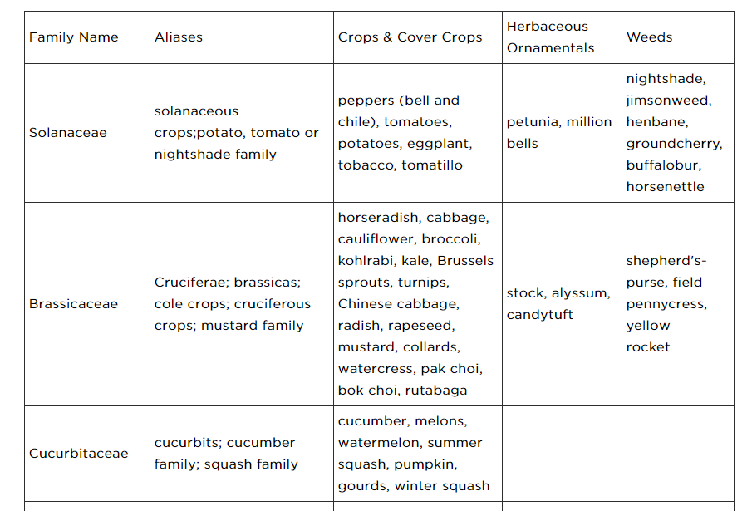

Slide 40
Breaking up the Disease and Pest Cycle: Integrated Pest Management
Soil health practices
Crop diversity
Crop rotation
Mulching
Insect netting
Traps and lures
Building predator and beneficial insect and bird habitat

Slide 41
The Case of the Tomato Plant
In a recent study of tomato plants…and parasitic wasps, Jennifer Thaler, a UC Davis postdoctoral fellow, found that wasps on tomato plants whose defense systems had been artificially stimulated killed twice as many caterpillars as did wasps on untreated plants.”

Slide 43
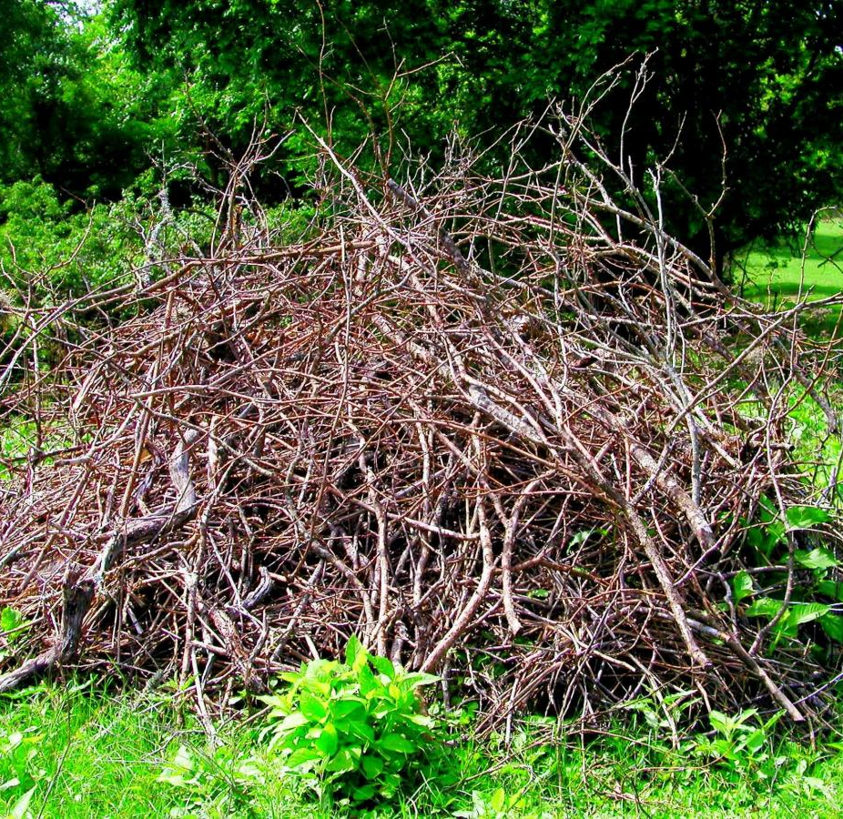
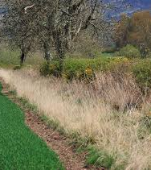
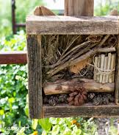
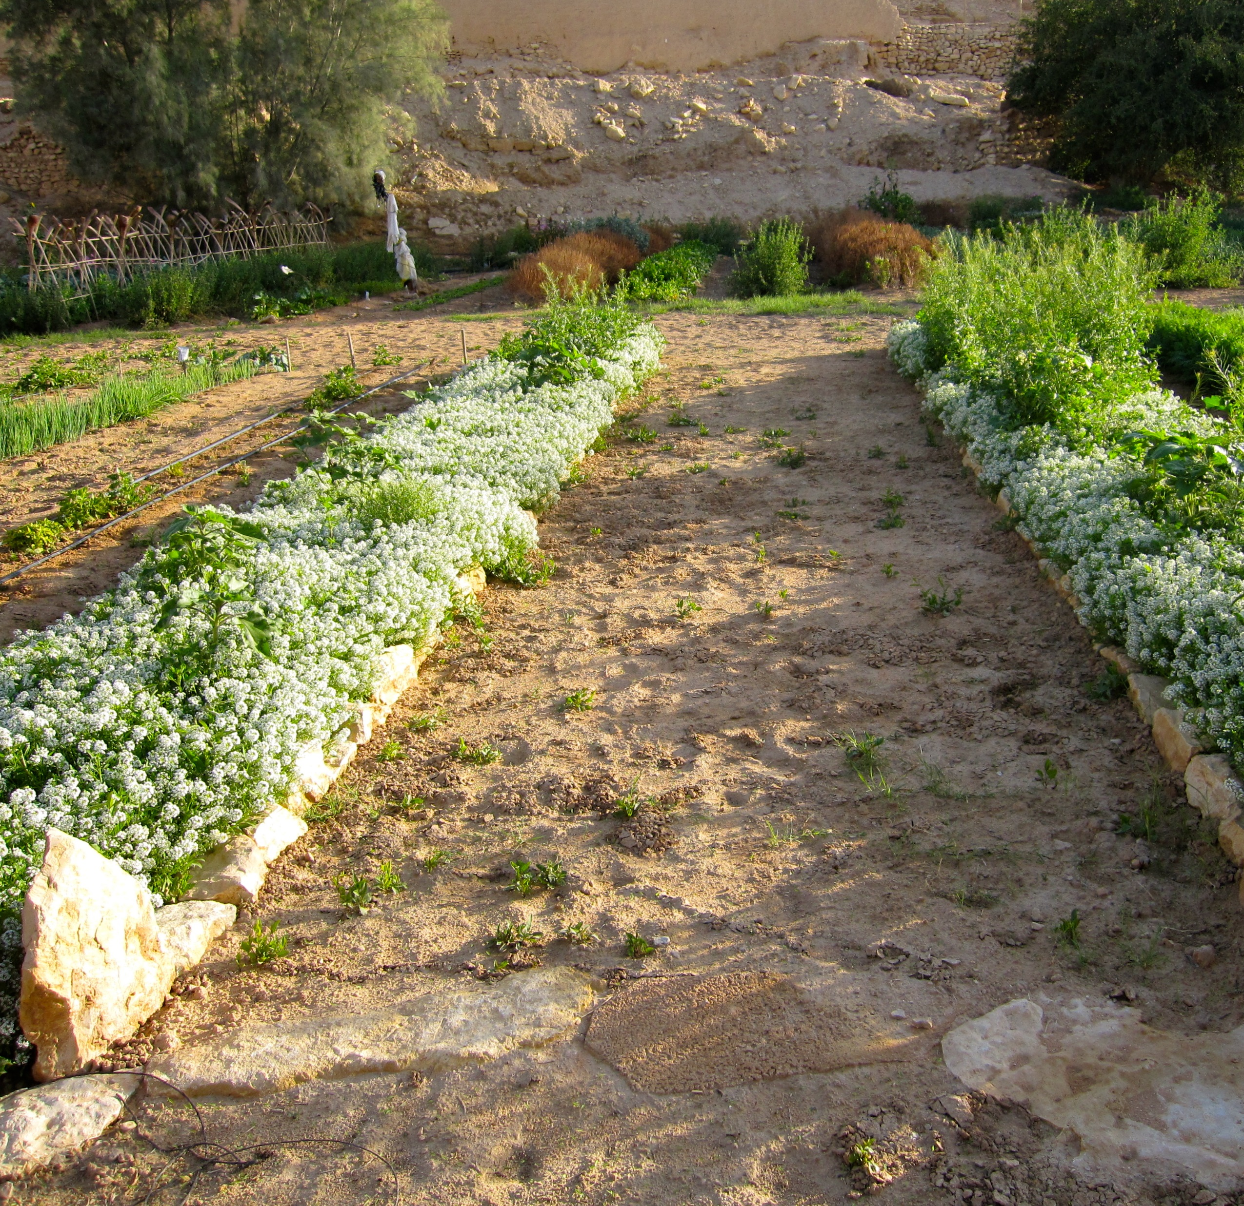
Beneficial Habitat
Notes:
Beneficial habitat diversifies the plant ecology and offers food and home to beneficial insects which act as predators to pests.
Brush piles
Insect hotels
Beetle banks with sedges and grasses
Insect Habitat
…but also beneficial native plants

Slide 44
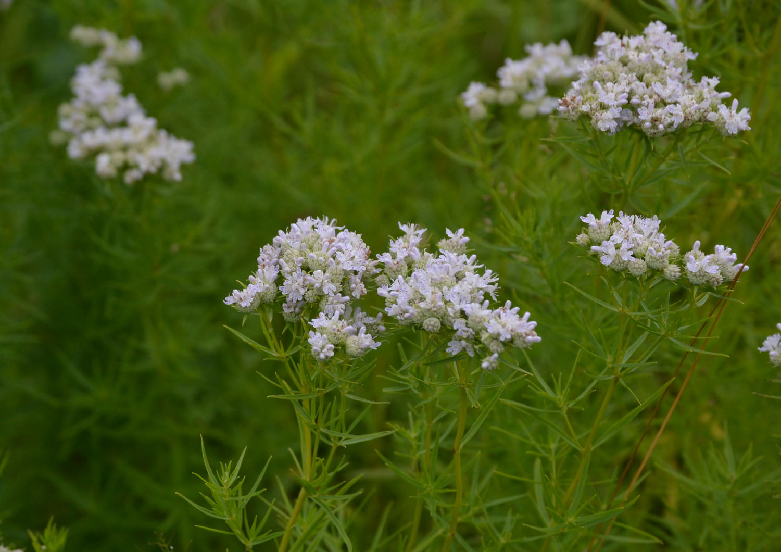
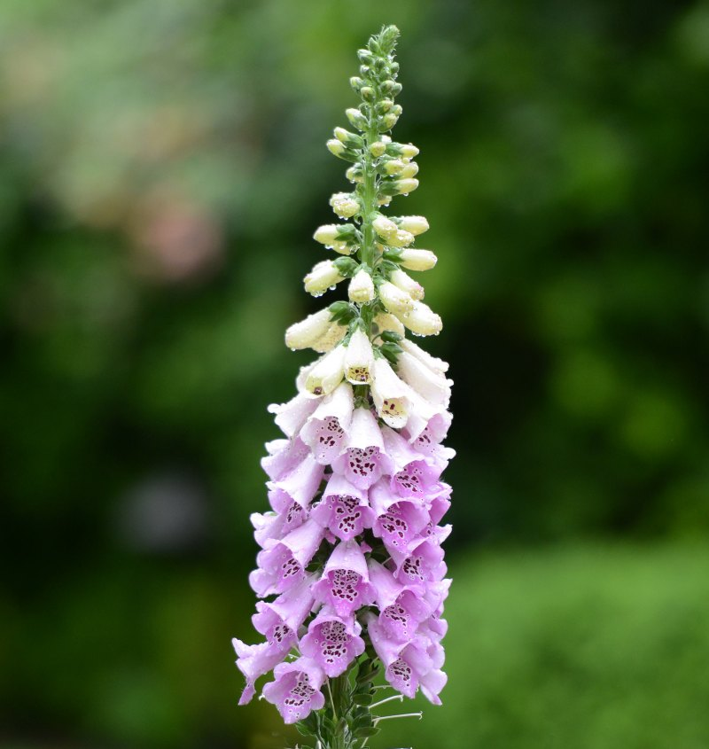
Foxglove Beardtongue
Narrowleaf Mountainmint
False Indigo Bush
New Jersey Tea
Notes:
Narrowleaf Mountainmint
False Indigo Bush
New Jersey Tea
Foxglove Beardtongue

Slide 45
Notes:
Break up fragmentation, remove turf, etc.

Slide 46
Integrated Pest Management: Japanese Beetles
Notes:
I figure the best way to illustrate this is to use some practical examples…
A client of mine experience some serious Japanese Beetle issues a few years ago but didn’t want to use a synthetic chemical on his grapes and other vegetables. So I developed some options that he can try to manage the pest and improve overall ecological health.

Slide 47
Notes:
There are cultural methods
As it turns out, Japanese beetles love to lay their eggs in short trimmed grass. So I suggested, during the egg-laying stages from early July to early August, to consider mowing your grass no lower than 4”. This would limit their ability to lay eggs in his yard while also encouraging ground beetle habitat (the good guys) to attack any other pests.
Unfortunately, Japanese beetles will travel up to 5 miles for food if needed. So, this may not be enough.

Slide 48
Notes:
Handpicking – but this is very laborious. Surely there are other things that can be done.

Slide 49
Notes:
Netting
Knowing the exact dates for the growth cycle and development of a grape vine is difficult because it depends so much on the cultivar, species, and weather conditions. Below is an estimated timeline including the estimated dates for installing netting.
4/10 – 6/18 – Bud Development
4/24 – 7/2 – Grape could be flowering during this time
7/2 – Likely last date for flower to fertilize.
6/10 to 6/15 – Place netting to protect against Japanese Beetles.

Slide 50
Attract Predatory Birds
Notes:
Three native birds have been known to have a taste for Japanese Beetles; Robins, Gray Catbird, and Cardinals.
Developing habitat for them may have some benefit.
Gray Catbirds: “To attract Gray Catbirds, plant shrubs in areas of your yard near young deciduous trees. Catbirds also love fruit, so you can entice them with plantings of native fruit-bearing trees and shrubs such as dogwood, winterberry, and serviceberry.” (Source)
Cardinals: “Nearly any bird feeder you put out ought to attract Northern Cardinals…, but they particularly seem to use sunflower seeds. Leave undergrowth in your backyard or around the edges, and you may have cardinals nesting on your property. o Feeder and Food Preferences
Robins: This species often comes to bird feeders. Consider putting up a nest box to attract a breeding pair. Make sure you put it up well before breeding season. Attach a guard to keep predators from raiding eggs and young. (Source) o Feeder, Nestbox, and Food Preferences

Slide 51
Develop Habitat for Predatory Insects
Notes:
Develop Habitat for Predatory Insects
Japanese Beetles do have a few predatory insects for which a habitat can be nurtured to support their population.
Wheel bugs
Spring Tiphia

Slide 52
Providing Habitat for Wheelbugs
Notes:
Wheel bugs (Arilus cristatus)
Wheel Bugs are known for going after caterpillars and Japanese Beetles
“generalist predators of aphids, grasshoppers, caterpillars, beetles, and various other insects, including other beneficial insects.” The “kill more prey than they need…”,
To promote the population of Wheel Bugs, which, apparently are very shy and rarely seen, there are a few things you can do:
Use insecticides and pesticides judiciously if at all.
They lay their eggs in autumn in brush piles, leaves, bark, and twigs. They love hedgerows and leaves, especially.
They like to ambush prey while hanging out on flowers. Plant flowers close to garden.
They may drink nectar when prey is scarce.
Provide alternate prey habitat through cover crops (Crimson Clover, Buckwheat, Partridge Pea, etc.), insectary plantings and permanent plantings such as hedgerows using shrubs and trees like: Basswood, Buffaloberry, Coffeeberry, Buttonbush, Elderberry, False indigo, Hawthorn.
A list of native flowers that will benefit and support Wheel Bug populations include, but are not limited to: (Insectorary)
• Goldenrod
• Golden Alexander
• Blanketflower/Indian Blanket
• Aster
• Compass Plant, Cupplant, Rosinweed
• Daisy Fleabane
• Globe Gilia
• Lanceleaf Coreopsis
• Meadowfoam
• Milkweed
• Rattlesnake Master
• Plains Coreopsis
• Purplestem Angelica
• Sunflower

Slide 53
Providing Habitat for Spring Tiphia
Released in Indiana in early 1990’s
Only attack Japanese Beetles and beetle grubs
Likely populations in Hamilton County
Encourage habitation by planting umbelliferous flowers:
Dill
Purplestem Angelica
Hairy Angelica
Meadow Zizia
Golden Alexander
Purple Meadow Parsnip
Yellow Pimpernel
Snakeroot
Etc.
Notes:
Spring Tiphia (Tiphia vernalis)
Another insect predator of Japanese Beetles is the Spring Tiphia (Tiphia vernalis). They were released in Indiana in the early 1990’s. There are likely populations in Hamilton County. To encourage their habitation, plant flowers with umbelliferous flowers including:
• Wild Carrot
• Dill
• Purplestem Angelica
• Hairy Angelica
• Meadow Zizia
• Golden Zizia (Golden Alexander)
• Purple Meadow Parsnip
• Hairyjoint Meadow Parsnip
• Yellow Pimpernel
• Red River scaleseed
• spreading chervil
• spotted water hemlock
• Canadian honewort
• harbinger of spring
• Snakeroot
• Stiff Cowbane
• Hemlock Water Parsnip
There are others you can find here at this link. In addition to this, many of the species of plants can be purchased as plugs or seeds. Contact the HCSWCD for further assistance.

Slide 54
Notes:
Moles! Yes, they eat grubs.

Slide 55
Organic Pesticide: Spinosad
Spinosad is a natural substance made by a soil bacterium that can be toxic to insects.
It does not appear to be toxic to honey bee’s and other beneficial insects once dry.
There may be a time of day when applying this to your plants is more beneficial to avoid most insects all together.
Notes:
It does not appear to be toxic to honey bee’s and other beneficial insects once dry.
There may be a time of day when applying this to your plants is more beneficial to avoid most insects all together.

Slide 56
Organic Pesticide: Bacillus thuringiensis galleriae (BTG)
Attacks the grubs only
Should be used on lawn and garden
A naturally occurring soil bacterium
It’s a stomach poison and must be ingested to be effective
Apply to the soil as you would insecticides
Notes:
BT (Larvae Stage)
“Bacillus thuringiensis (Bt) is a naturally occurring soil bacterium typically used as a microbial insecticide.
The Bt strain registered for the Japanese beetle is for use on the grub stage only.
Bt is a stomach poison and must be ingested to be effective. Apply it to the soil as you would insecticides. Effectiveness is similar to that of insecticides.” (Source: USDA)
BT can be purchased. Specifically, BTG (Bacillus thuringiensis galleriae) is what is needed.

Slide 57
Organic Pesticide: Milky Spore
Bacillus papillae.
Apply to turf and lawn
Grubs ingest it, die, and release more spores.
Takes 2 to 4 years to build up in soil.
Most effective when treated community-wide.
Notes:
Milky Spore
Bacillus papillae.
Apply to turf and lawn
Grubs ingest it, die, and release more spores.
Takes 2 to 4 years to build up in soil.
Most effective when treated community-wide.

Slide 59
Andrew Fritz
Andrew.fritz@hamiltoncounty.in.gov
(317) 773-2181
www.hamiltonswcd.org

